Slide 1

Introduction
GROUP: 25-SANKALP
Problem Statement
According to the World Health Organisation, more than 1.25 million people die each year as a result of road accidents.
In 2018, England experienced the highest number of road fatalities, accounting for 85% of road deaths in the UK and subsequently resulted in nearly 2.2 million British Pounds being spent in prevention costs.The study focused on injury severity levels resulting from an accident using real data obtained from the UK Transportation Department.
Road Accidents usually occur due to combination of multiple factors.

Slide 2
Introduction
Proposed Solution
Use Data Analysis to build predictive machine learning models for detecting road accident severity by considering various factors associated with the accident.(such as weather conditions, time of day, accident location, mode of travel of the affected person, speed limit, junctions types, road type, road infrastructure needs, ambient lighting and other human factors.)
Example Hypothesis: Has the UK road accident severity declined over the years due to better road quality?
Aim: Identify patterns in Accident Data and propose mitigating steps for reducing fatal accidents.

Slide 3
Related Work
Reference-1
A Deep Learning Approach for Detecting Traffic Accidents from Social Media Data
Zhang et. al.
This paper employs deep learning in detecting the traffic accident from social media data. First, we thoroughly investigate the 1-year over 3 million tweet contents related to traffic accidents in two metropolitan areas.
https://arxiv.org/ftp/arxiv/papers/1801/1801.01528.pdf

Slide 4
Related Work
Reference-2
An Improved Deep Learning Model for Traffic Crash Prediction
Dong et. al.
A deep learning model is proposed to explore the complex interactions among roadways, traffic, environmental elements, and traffic crashes. The proposed model includes two modules, an unsupervised feature learning module to identify functional network between the explanatory variables and the feature representations and a supervised fine tuning module to perform traffic crash prediction.
https://www.hindawi.com/journals/jat/2018/3869106/

Slide 5
Related Work
Reference-3
Investigation of injury severity in urban expressway crashes: A case study from Beijing
Yuan et.al.
A Investigation of injury severity in urban expressway crashes: A case study from Beijing
https://journals.plos.org/plosone/article?id=10.1371/journal.pone.0227869

Slide 6

Dataset
Dataset from Kaggle, contains UK car accidents data from year 2005-2015.
Accidents.csv consists of 1,651,142 records with 32 attributes. (Accident Info)
Casualties.csv - consists of 2,216,720 records with 15 attributes. (Pedestrian/Driver Casualty Info)
Vehicles.csv - consists 3,004,425 records with 22 attributes. (Vehicle Involved Info.)
For our predictive modelling purpose, we use the column “Accident Severity” as the target variable to predict. The variable value ranges from 1 to 3 which stands for Fatel, Serious and Slight respectively.
Notes:
Hi, I’m Prasanth and I will be talking about the datasets and data-preprocessing steps we used for our project. we used UK car accident

Slide 7

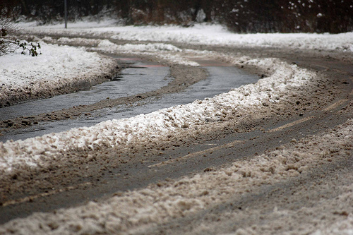

Dataset
Nominal Attributes
Accident Index, Gender, Light conditions (Daylight, Darkness, Darkness-no lighting), Weather conditions (Fine, no high winds, Raining, Snowing, Fog/mist, Unknown), Road Surfaces (Dry, Wet/Damp, Snow, Frost/ice)
Ordinal Attributes
Accident Severity
Interval Attributes :- Timestamp, Location (Lat. Long.)
Ratio :- Engine Capacity, Age of Driver, Age of Vehicle

Slide 8

Data Pre-Processing
Several Pre-processing techniques have been used to make the dataset more viable for data mining tasks
NA values :- Lot of NA values were present in the Data. We have dropped the rows containing NA values in it.
Handling categorical attributes :- Most attributes for numerical data, either discrete or continuous. For accident severity, which ranges from 1 to 3, we have used one-hot encoding to represent this information. Other attributes we used as it is, like 1- Dry, 2- Wet, 3- Snow .,etc for road conditions
Handling Few Continuous attributes :- Some continuous Date Attributes like latitude, longitude and timestamp were removed for modelling fatality severity, as they don’t provide contextual features necessary to train. Other attributes like Engine Capacity were kept.

Slide 9
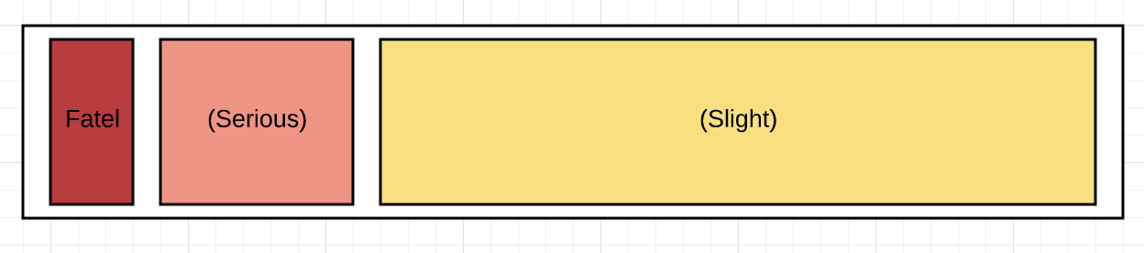
Data Pre-Processing
Dataset sampling :- The dataset provided was skewed, it was originally 1:10:68, but to consider class imbalance into account, we reduced it to 1:4:16 for our predictive models.
Normalization and Standardization:- We used standard pre-processing libraries to normalize our widely different numerical attributes. This means computing the mean and taking the difference between each value and mean.

Slide 10
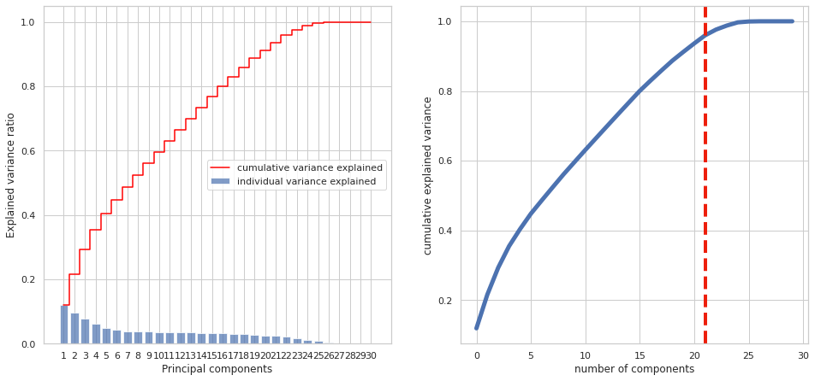
Principal Component Analysis

Slide 11
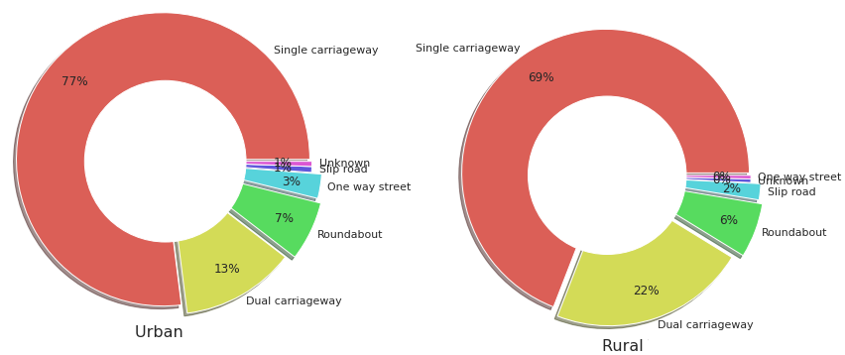
Important EDA Graphs

Slide 12
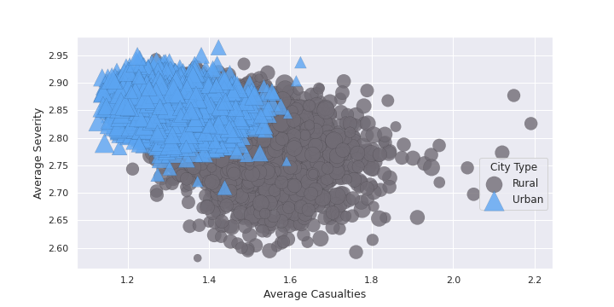
Important EDA Graphs

Slide 13
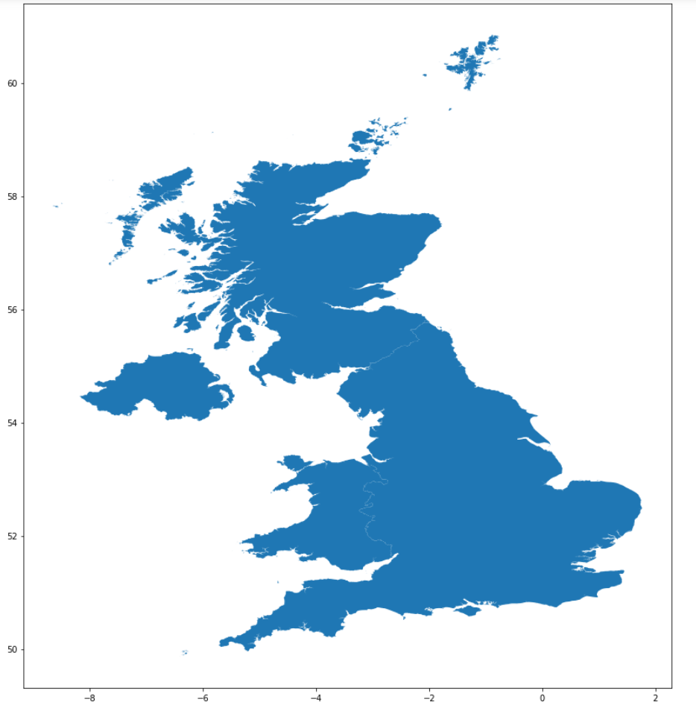
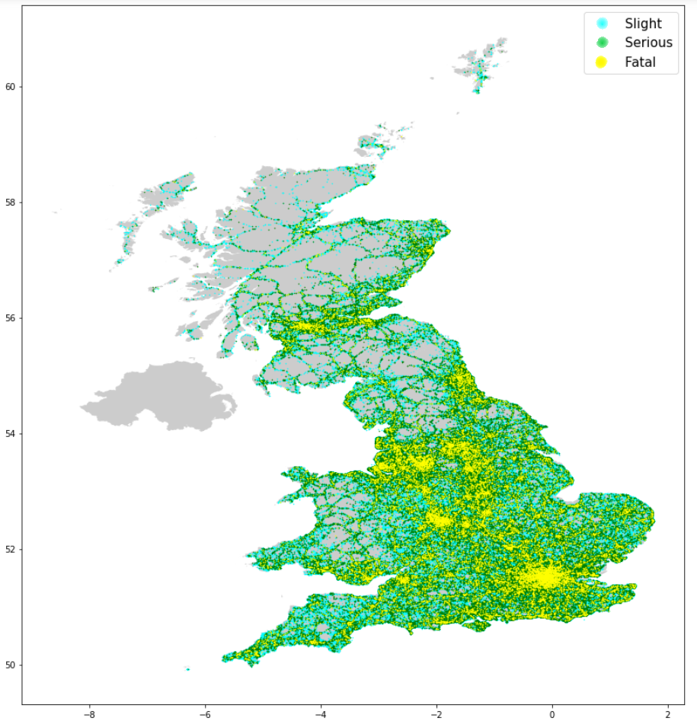
Spatial Data Analysis
iGIS Map’s UK Map used as base

Slide 14
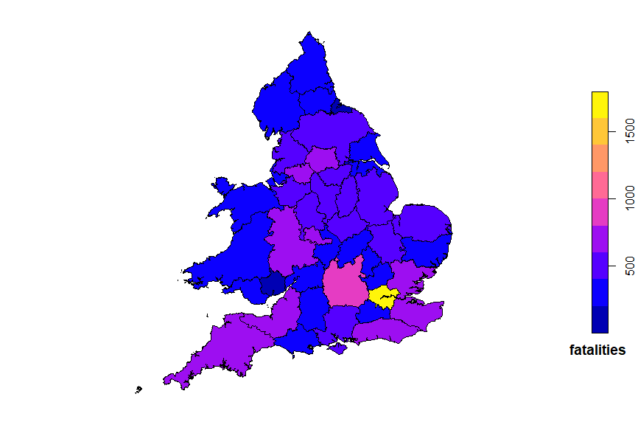
Spatial Data Analysis
City of London Police and
Metropolitan Police
Services (shown in Yellow)
Thames Valley Police
(shown in bright Pink)

Slide 15
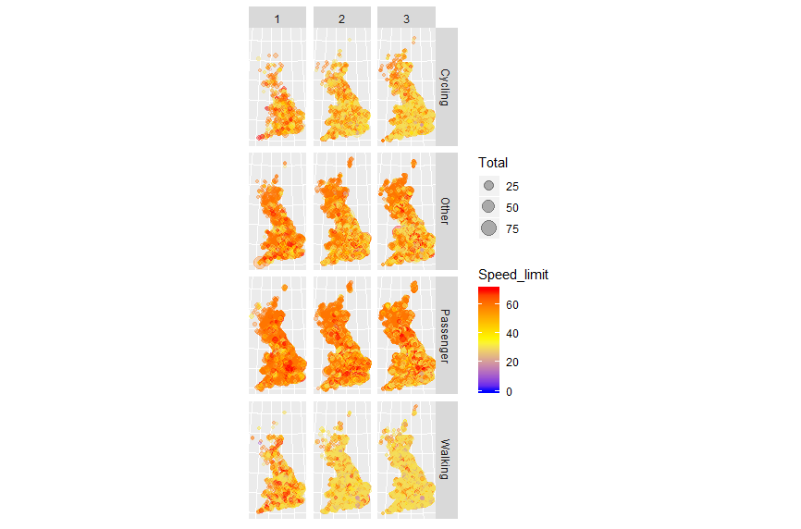
Spatial Data Analysis
Various Pedestrians affected
Across a range of speed-limits

Slide 16
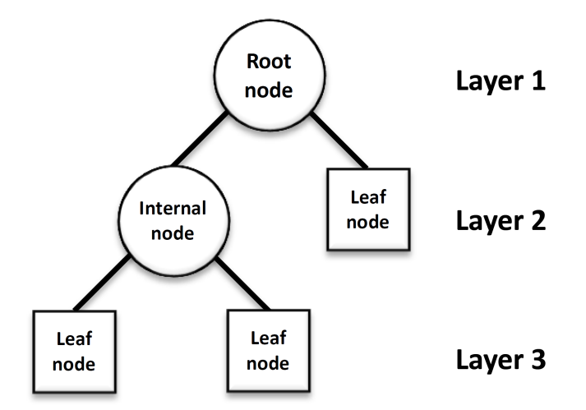
Generic Rule Generation
No Nominal Attributes used
Equal-sized samples taken concerning our target variables
Some of the rules extracted:
Higher count in each category of Severity when the speed is higher
Police more likely to be present at the Accident site
Higher casualties (>7) observed in high-speed accidents (>35).

Slide 17
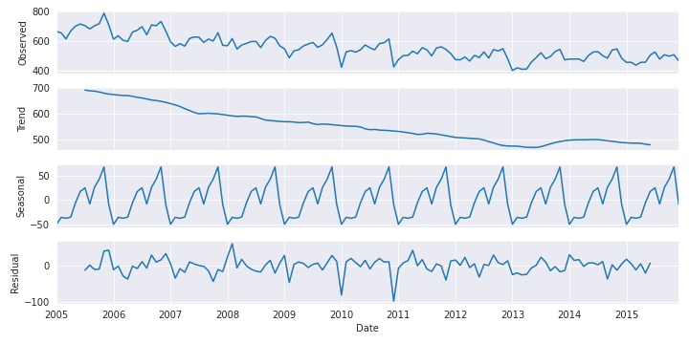
Temporal Data Analysis

Slide 18
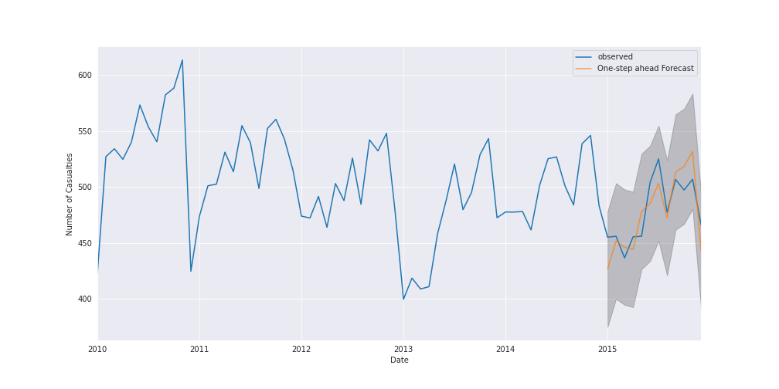
Temporal Data Analysis
The the predicted casualties are compared to the actual casualties.
RMS Error = 18.41
clearly captured the seasonality trend observed for the number of casualties each year.
As the forecast proceeds into the future, the confidence interval increases indicating uncertainty with time.
the model forecasts a decline in number of casualties with time and hence our test hypothesis is satisfied.

Slide 19
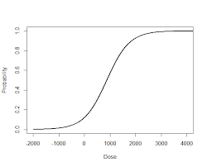
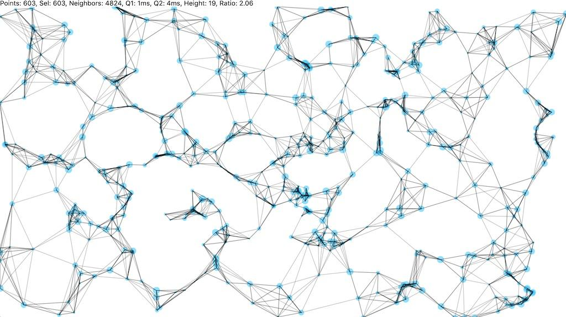
Methods
Logistic Regression
K- fold cross validation
n-splits=5
Each producing more or less the same results
L1 Lasso Regression
L2 Ridge Regression
Each was tested with and without the PCA components
K-Nearest Neighbors
HyperParameter tuning performed
3-fold cross validation
Model leaf size : [30,50]
Model n neighbors : [3,5]
Notes:
L1 and L2 with grid search

Slide 20
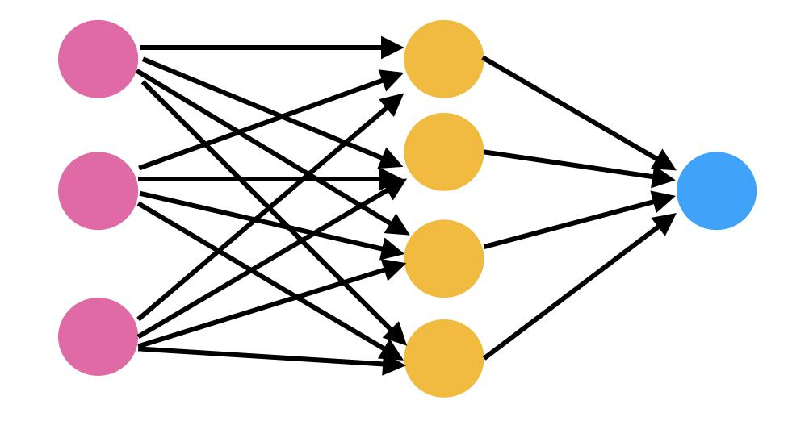
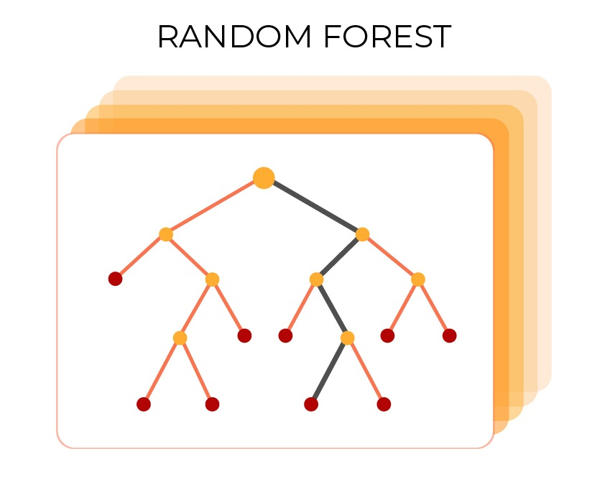
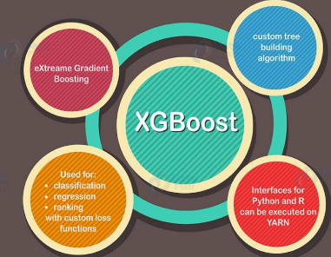
Methods-(contd)
Random Forest
Ensemble Learning Method
Operates by constructing a multitude of decision trees.
Parameters:
Split criterion : ‘Gini Index’
Number of trees : 100
XGBoost Classifier
Implementation of gradient boosted decision trees.
Designed for speed and performance.
Parameters:
Learning rate: 0.1,
Estimators: 140
colsample_bytree : 0.8
Neural Network
Feed forward neural network.
1 hidden layer - 10 neurons
1 output layer with 3 neurons.
Optimizers - SGD, Adam, RMSProp
Learning Rate - 0.001
Activation Function - ReLU

Slide 21

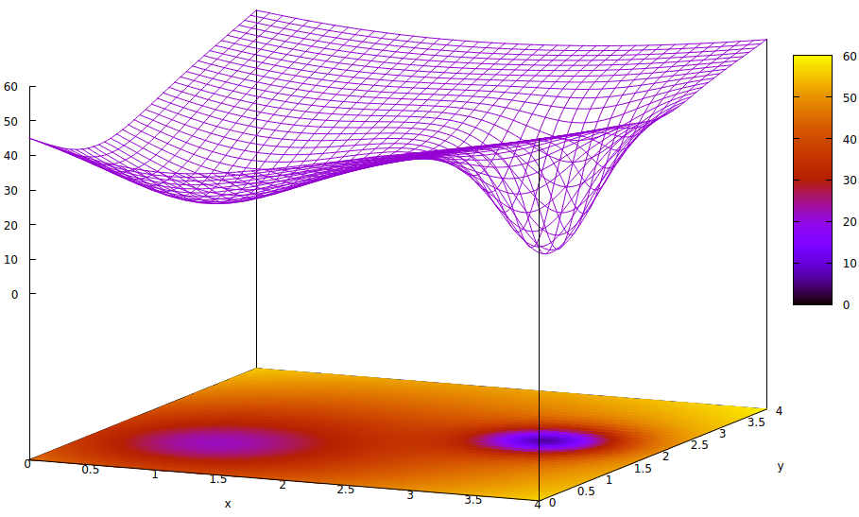
Results
Machine Learning Model | Training Accuracy | Test Accuracy
Logistic Regression | 76.19% | 76.20%
K-Nearest Neighbors | 79.01% | 71.86%
Artificial Neural Network | 76% | 75%
Random Forest | 100% | 76.02%
XGBoost Classifier | 76.40% | 76.24%

Slide 22

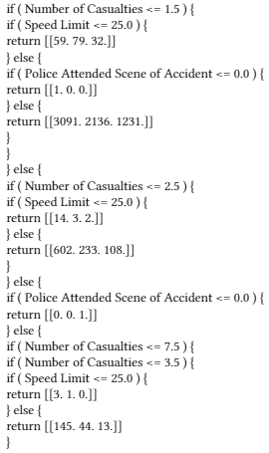
Discussion
Random Forest performed best - 100% Training Accuracy and 76% Test Accuracy.
The Time Series Analysis is able to forecasts a decline in number of casualties with time and hence our test hypothesis is satisfied.
Previous studies and AI techniques have used adaptive regression trees and rule mining classification in order to predict accident fatality rate over time.
Our work presents a novel comparative study of predictive machine learning models and presents metrics to compare performance. Important Features - Sex of the driver, Age of the driver, Light conditions, Weather conditions, Road Surface conditions, Journey Purpose of Driver, Engine Capacity.
Another novel technique we used was extracting rules from our decision tree classifiers.
Subset of the sampled data was extracted, and feed into a model and generic rules where extracted.
For speed-limits upto 35, involving 2 vehicles and at most 2 casualties, the police were at the site in 30% of cases.

Slide 23

Conclusion
Based on the Time Series Analysis, we can conclude that severe fatalities decreases with time.
Weather and Light conditions do not directly correlate to accident fatality rate.
In rural areas less frequent accidents occur, and if they do they are mostly severe.
In urban areas accident are more frequent but less severe.
Accidents mostly tend to occur during weekdays and peak work schedule hours.
Pedestrians and Cyclists are heavily affected by road accidents.
Accidents and number of casualties are linearly correlated.

Slide 24


